Slide 1
SMALL PRECISION TOOLS
Wedge Auto-Draw Requirements
Small Wire (SW) Wedge Series – VM Requirements
DOCUMENT NO.
DATE
PREPARED BY
STATUS
VM_REQ_Rev0_07202026
2026-20-07
Youssef
Draft

Slide 2
Scope
This document defines the production drawing, customer drawing, and overlay requirements for the VM Requirements series, covering both the finished wedge and the Pre-Ground Blank (PGB). Including VM45A, VF60B, VF45A,VU45A, VF60C, VF45P, VU60A, VU60C, VA55, VM45B, VM55B, VR45, VF55B, VM30A, VN45A,VR60, VU45C
SMALL PRECISION TOOLS
Confidential
04

Slide 3
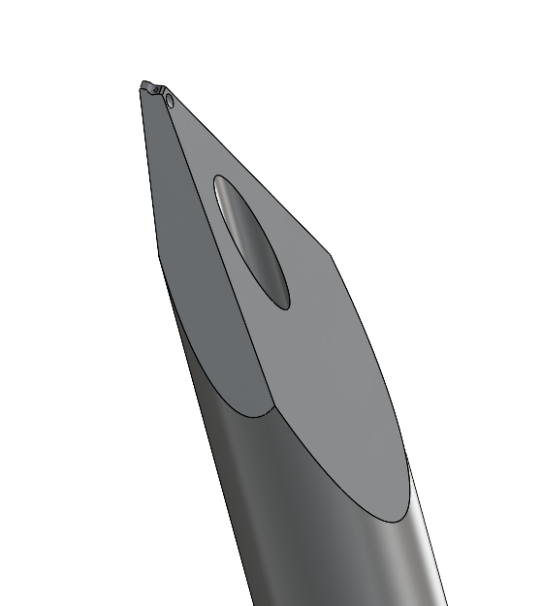
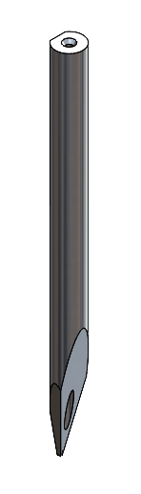
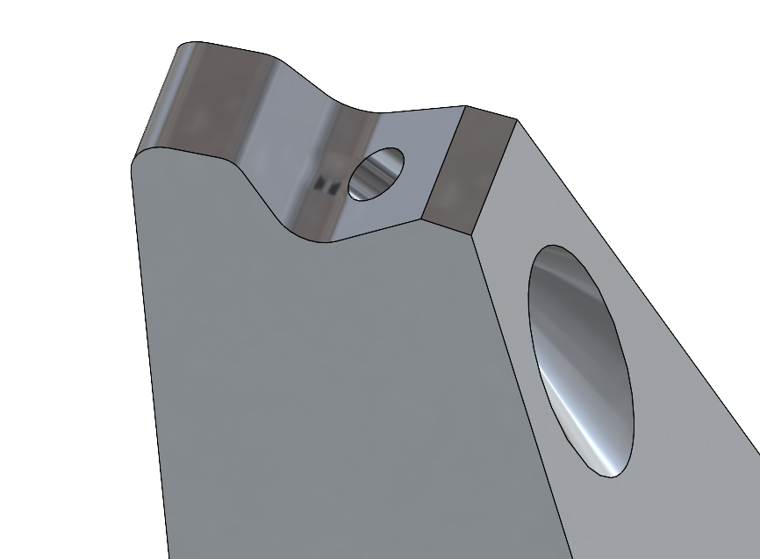
Tool Overview
SMALL PRECISION TOOLS
Confidential
04

Slide 4
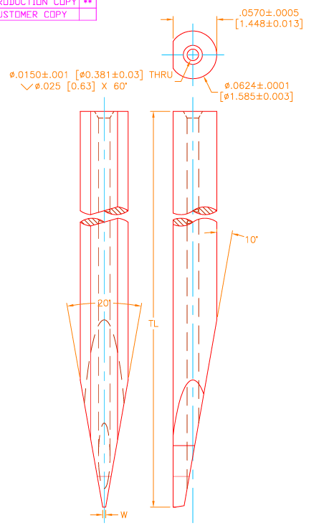
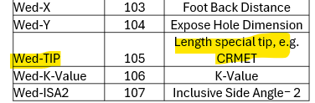
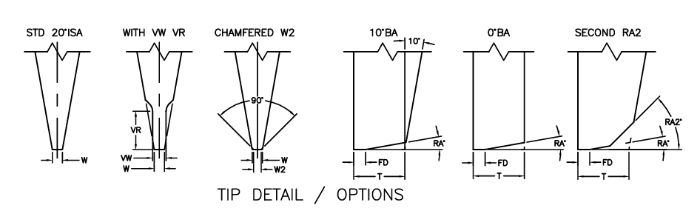
Configuration Options
Shank: SW_V with SLB feature , added Hole on top
For Tip detail we have STD 20°ISA , WITH VW VR , CHMFERED W2, 10°BA, 0°BA, SECOND RA2
Added hole parameters needed to be define !
Inputs from TM: 28-Aug-2026
- Please add the Wed_TIP (Join) dimension line for C, M and TI/TIB brazing part.
SMALL PRECISION TOOLS
Confidential
04

Slide 5
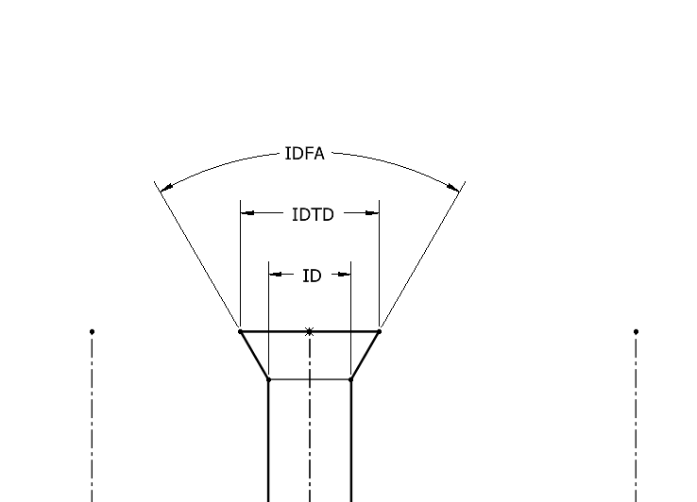
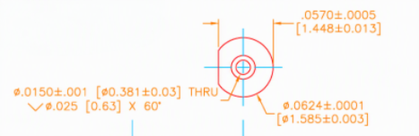
Top Hole Definition
Hole Parameters are ID, IDFA, IDTD, ID is THRU ALL
SMALL PRECISION TOOLS
Confidential
04

Slide 6
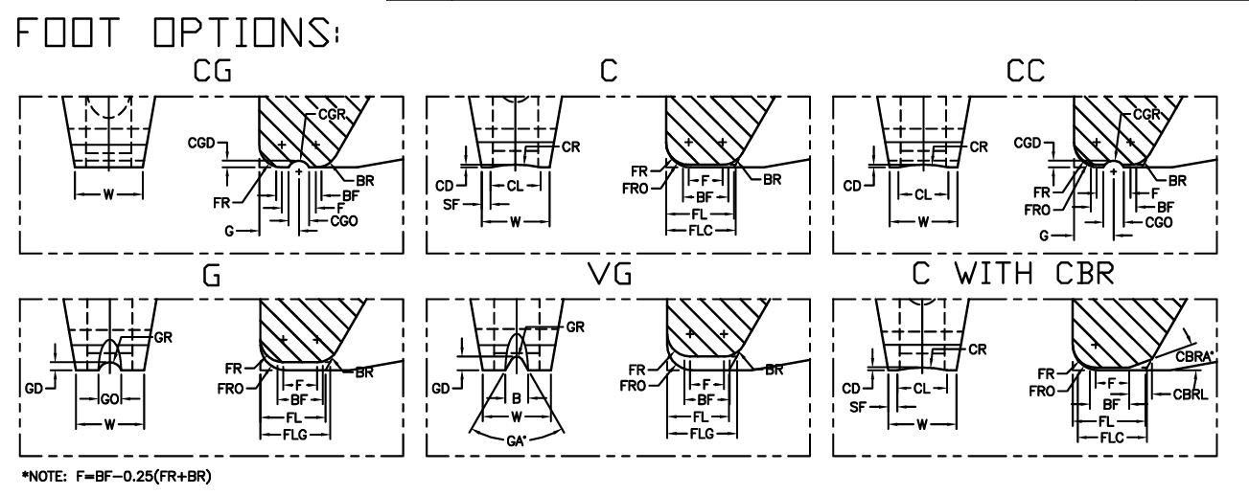
Configuration Options
Foot options: SW_C, SW_F, SW_CG, SW_G, SW_VG, SW_CC
SMALL PRECISION TOOLS
Confidential
04

Slide 7
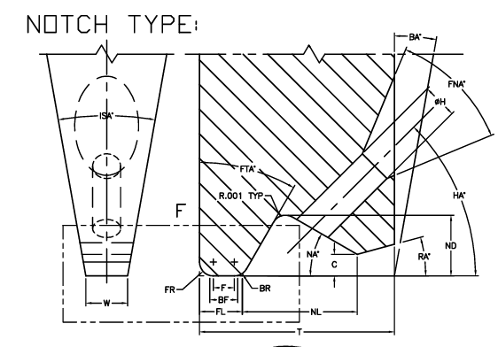
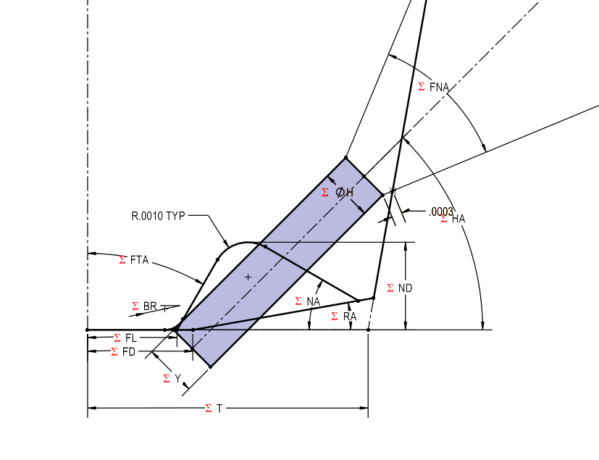
Configuration Options
Notch type: SW_LNotch,
Note : No need for the C value
SMALL PRECISION TOOLS
Confidential
04

Slide 8
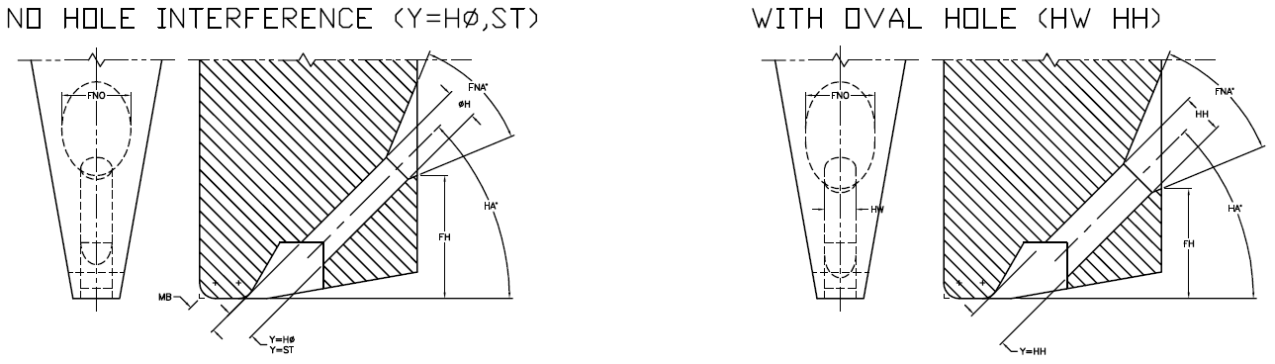
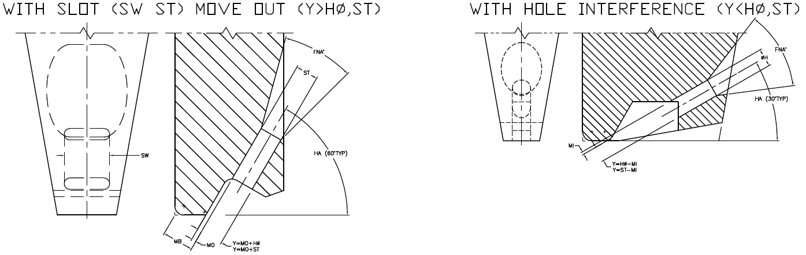
Configuration Options
Feed hole types: STD (Round), Oval, Slot
Note : Y will be used to position the hole
SMALL PRECISION TOOLS
Confidential
04

Slide 9
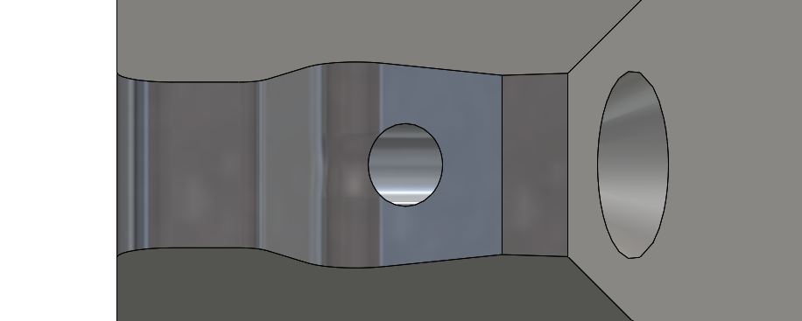
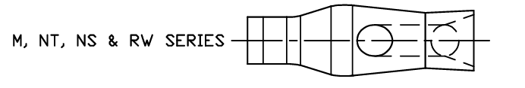
Configuration Options
BR feature: No Round BR
Note :
SMALL PRECISION TOOLS
Confidential
04

Slide 10
Database Requirements
Schema is largely consistent with the COB tool family.
 | drawing# | article# | partspec# | SG Description 2 | Sales 2019-2024 | drawing_title | wedge_title | TL_NOM
5 | 14001786 | 3112782 | 117721 | VM45B-TI-1510-.625-F | 5 | 140-01786-TF-B | VM45B-1510-F STANDARD (W=003) | 0.625
6 | 14001786 | 3112786 | 117724 | VM45B-TIB-1510-.625-F W=003 | N/A | 140-01786-TF-B | VM45B-1510-F STANDARD (W=003) | 0.625
7 | 14009295 | 3112787 | 117726 | VM45B-TIB-1510-3/4-F DBL=500 | 10 | 140-09295-TF-A | VM45B-1510-F SPECIAL (DBL=500) | 0.75
8 | 14009295 | 3112788 | 117727 | VM45B-TIB-1510-3/4-FM DBL=500 | N/A | 140-09295-TF-A | VM45B-1510-F SPECIAL (DBL=500) | 0.75
Note : We may need to add the fields like Wedge type; Foot type; etc.
Note : We will need to add some rules of data handling !
SMALL PRECISION TOOLS
Confidential
04

Slide 11
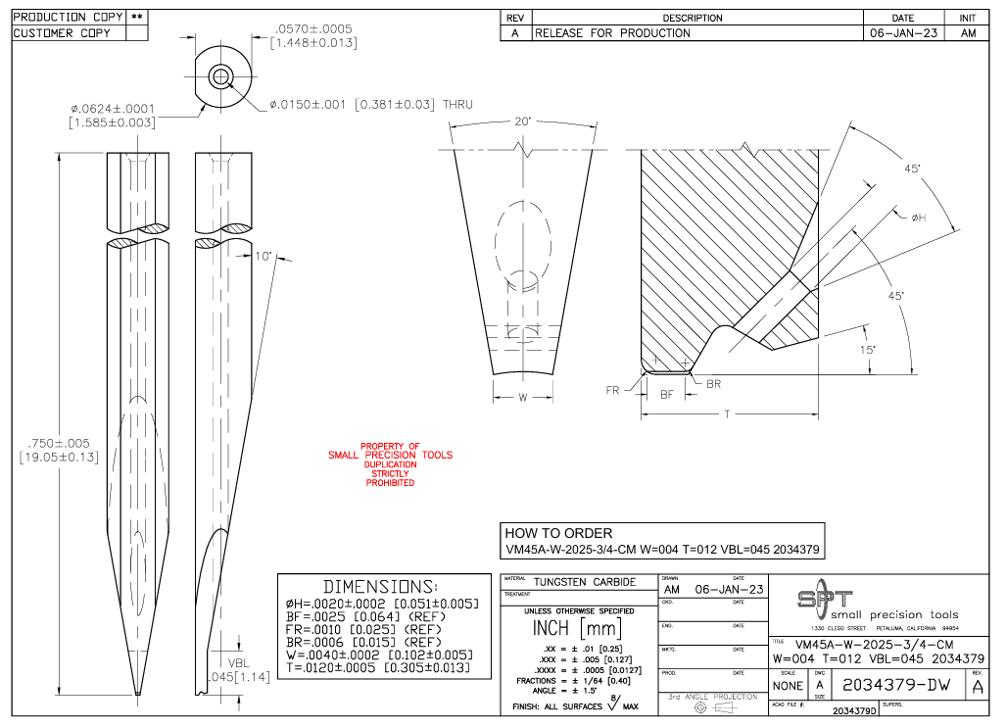
Customer Drawing Requirements
For customer drawing we will replicate as the same provided, following the same step as COB
Front, Right & Top Views
Detail & Section Views
Dimensions Tables
Note : Noticed the VFL has an angle, but Not define in the DB
SMALL PRECISION TOOLS
Confidential
04

Slide 12
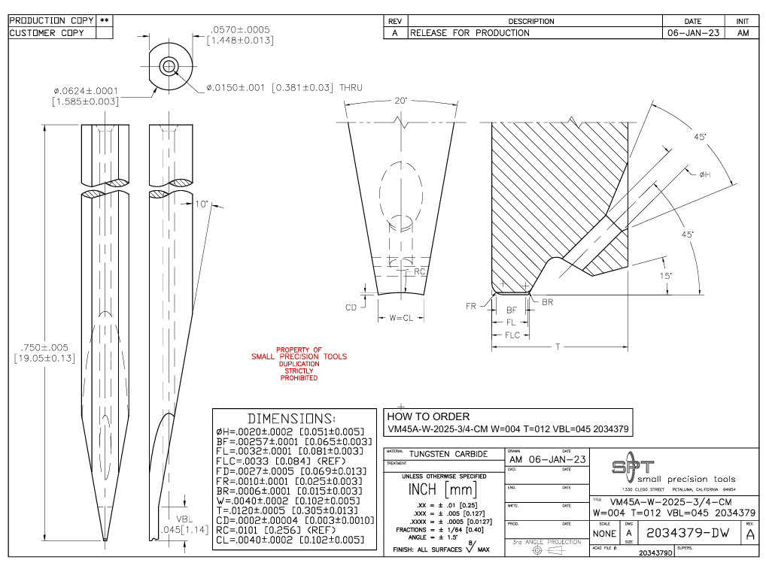
Production Drawing Requirements
For customer drawing we will replicate as the same provided, following the same step as COB
Front, Right & Top Views
Detail & Section Views
Dimensions Tables
Add all dimensions and parameters to views
Note : The production drawing will follow the same as sample provided
SMALL PRECISION TOOLS
Confidential
04

Slide 13
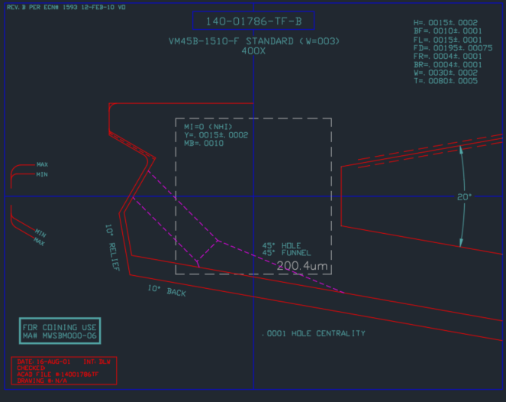
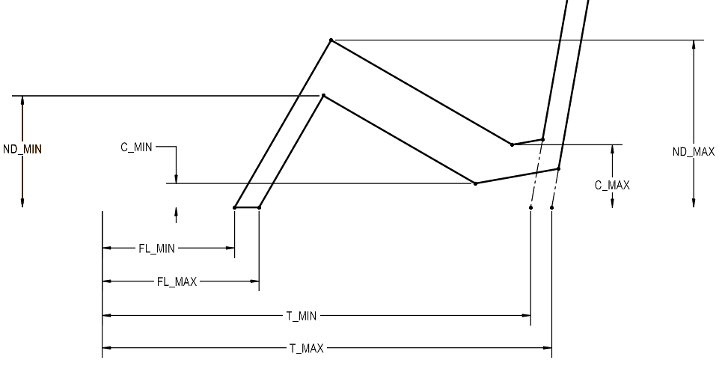
Overlay Requirements: Finish Wedge
Like COB overlay, with different tolerance zone construction. .
Note : Scaling the view the same way as COB, The T dimension start from TDF
Note : Only add two views to the overlays
Note : No need to all the annotations
SMALL PRECISION TOOLS
Confidential
04

Slide 14
Overlay Requirements: PGB
Remains unchanged from the standard wedge overlay used across all tool families. Feed Hole added
Note : The PGB may have the VR/VW version !
SMALL PRECISION TOOLS
Confidential
04

